Slide 1
DIAMOND PRICE PREDICTION APPLICATION
Steps for Deploying application on Heroku cloud PLATFORM from scratch.

Slide 2
INTRODUCTION TO HEROKU
Heroku is a cloud platform as a service (PaaS) supporting several programming languages..
The Heroku network runs the customer's apps in virtual containers which execute on a reliable runtime environment. Heroku calls these containers "Dynos".
These Dynos can run code written in Node, Ruby, PHP, Go, Scala, Python, Java, or Clojure.
Heroku also provides custom build packs with which the developer can deploy apps in any other language.
Heroku lets the developer scale the app instantly just by either increasing the number of dynos or by changing the type of dyno the app runs in.

Slide 3
STEP 1:
Along with your application files you need to take care of below mentioned steps:
1) You need all the below mentioned files for deployment: a. requirements.txt b. Procfile c. setup.sh (You need setup.sh only for Streamlit)
2) Auto detect the app type.
3) git push & start running.

Slide 4
STEP 2:
Create a Python Virtual Environment
(Virtual Environment can be created by different ways, here I have used cmd.)
1. pip list 2. python -m venv my_env/ (my_env is the name of the virtual environment) 3. .\my_env\Scripts\activate => activate virtual environment in Windows where project file. 4. deactivate
Install these packages in virtual environment:
pip install matplotlib seaborn plotly sklearn
(NOTE: This are packages used for my application, you should install packages as per the need of your application)
Create requirement.txt file using below mentioned command:
pip freeze > requirements.txt

Slide 5
STEP 3:
This part is required for NLP Projects.
import nltk
nltk.download(‘ stopwords')
nltk.download('wordnet')
Procfile (For Flask).
web: gunicorn app:project web - Create a Web Dynos gunicorn app - If multiple people use my app, gunicorn make sure of multi threading and processing app
Procfile (For Streamlit)
web: sh setup.sh && streamlit run project.py

Slide 6
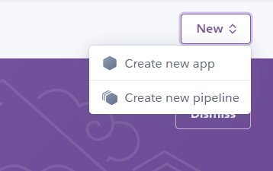
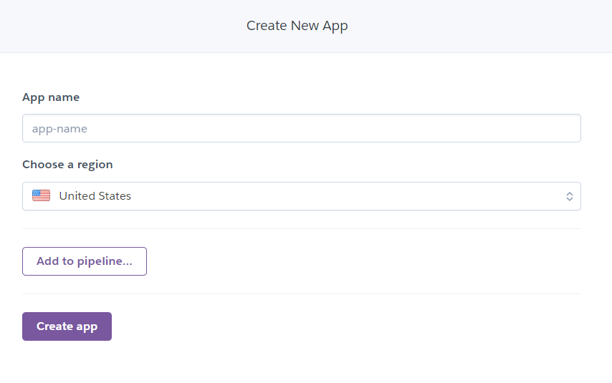
STEP 4:
First of all you have to create an account on Heroku.
www.heroku.com
After Successfully creating an account on Heroku, Create new app.

Slide 7
STEP 5:
After creating new app go to the cmd and follow the commands given:
Install Heroku CLI and Git
heroku login
Create a git repo and commit it locally
git init . git add * git commit -m “ commit_message ”
heroku git:remote -a app_name git push heroku master
Run –
Heroku run bash -a app_name
Stop –
Heroku ps:scale web=0 -a app_name

Slide 8
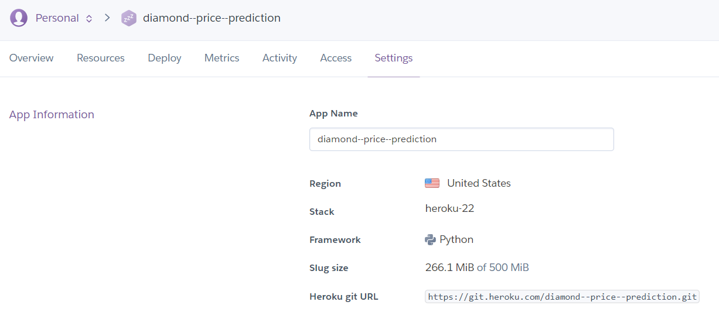
STEP 6:
Your code will run and the link for your app will be generated:
My application link: https://diamond--price--prediction.herokuapp.com/
SUCCESSFULLY DEPLOYED ON HEROKU CLOUD PLATFORM.

Slide 9
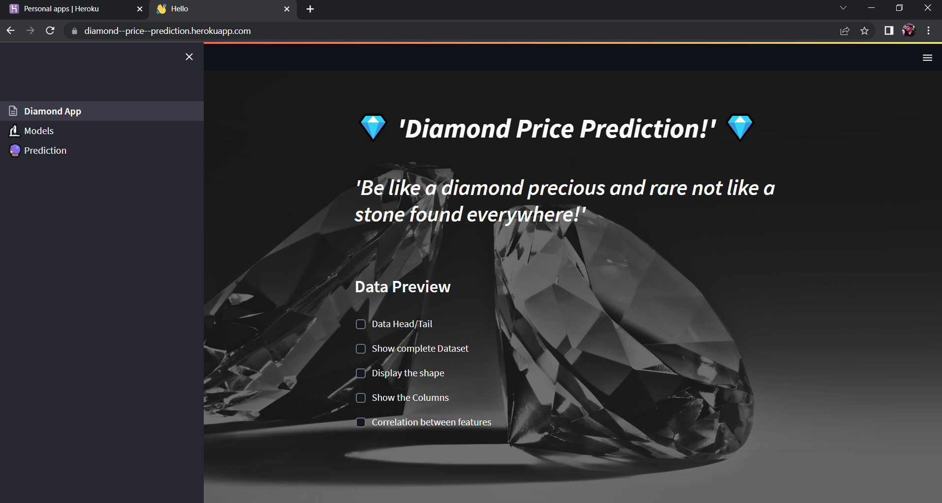
DIAMOND PRICE PREDICTION APPLICATION

